Slide 1
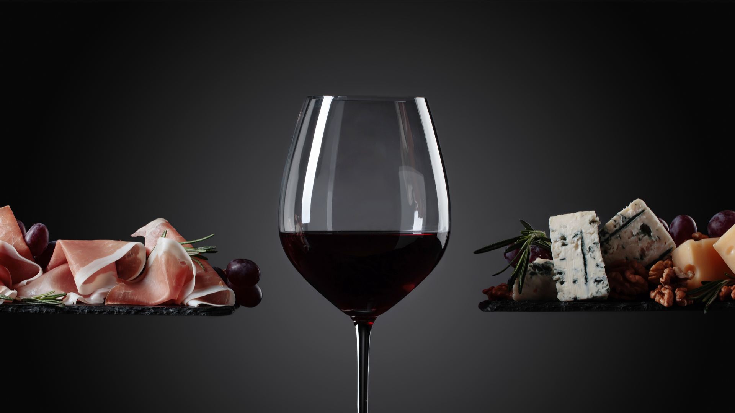
FOOD,WINE AND PREP!

Slide 2
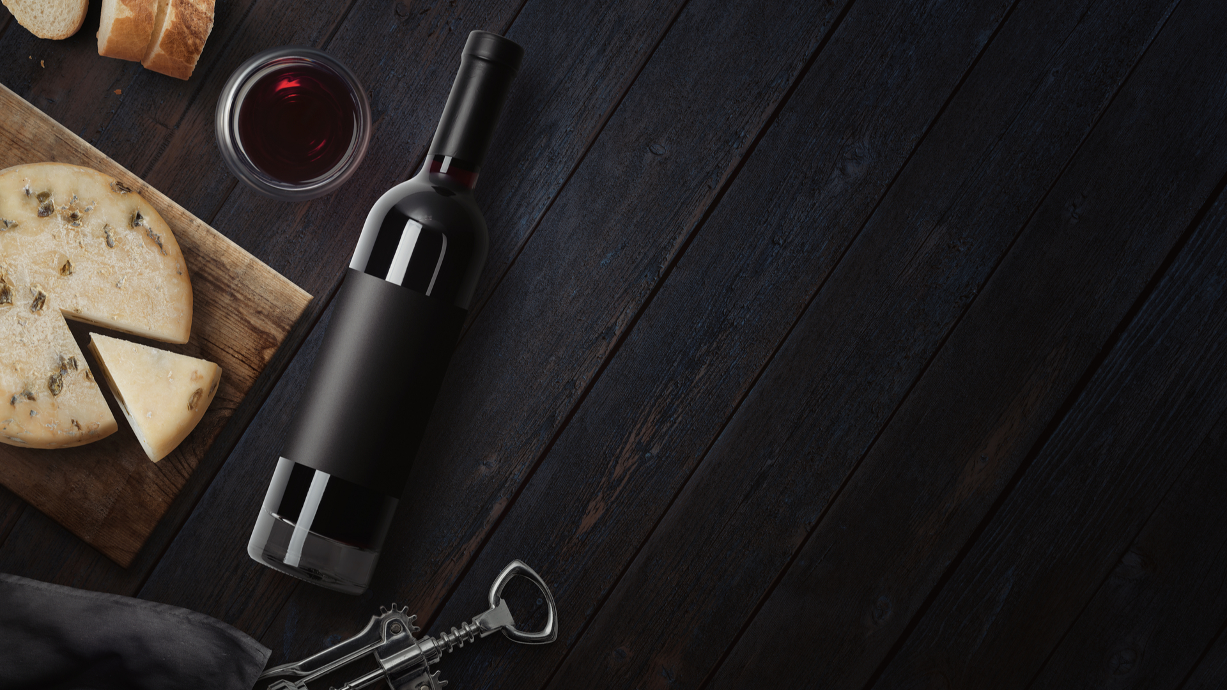
WHAT IS SPOONACULAR ??
THE FOOD API

Slide 3
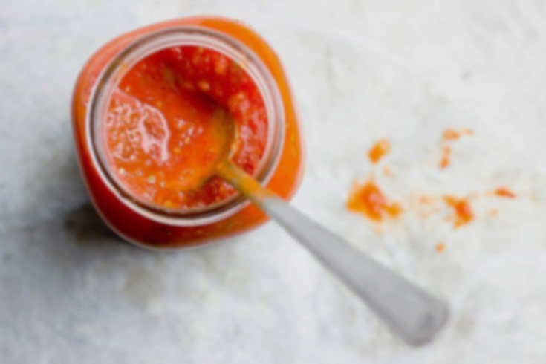
The Narrative
What the end-user will experience
Leave an impression
Explore the options
Customization of meals
Valuing end-users time

Slide 4
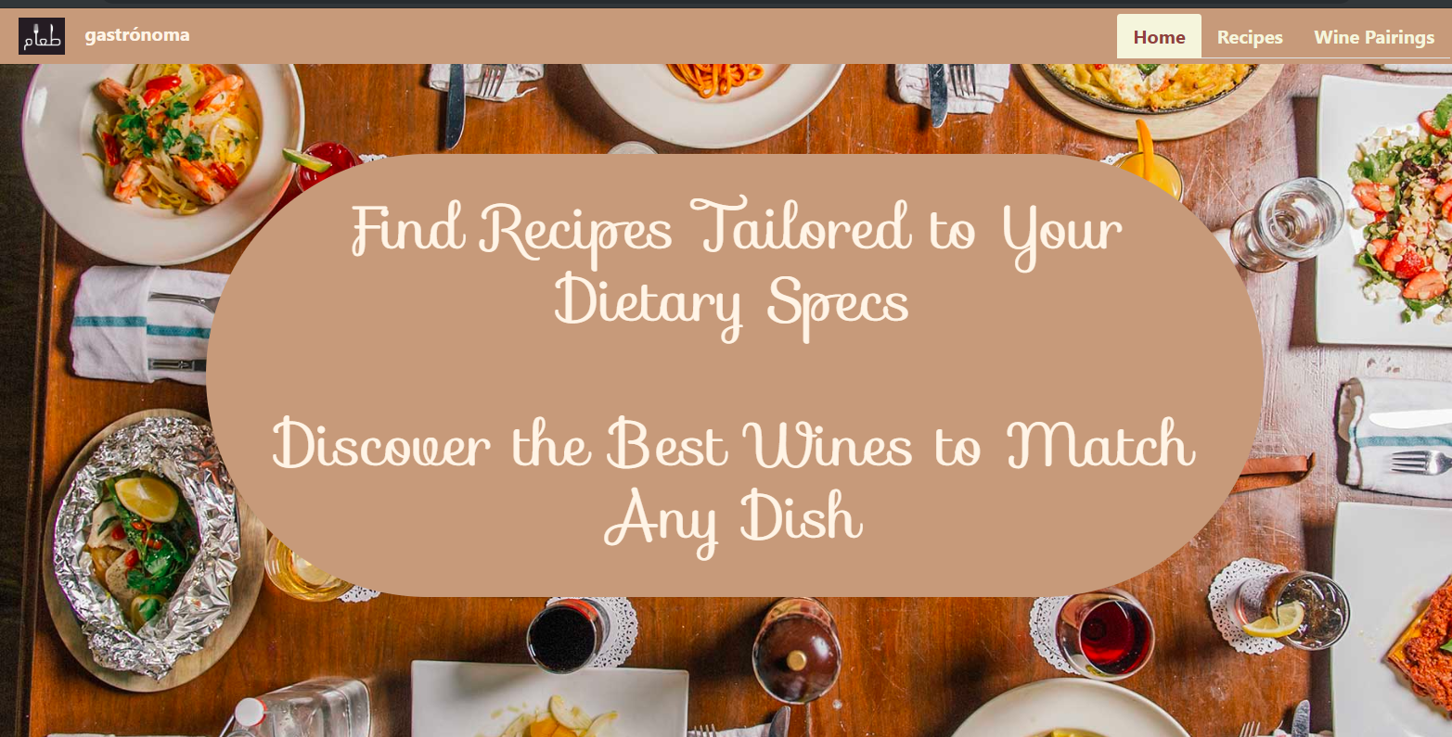
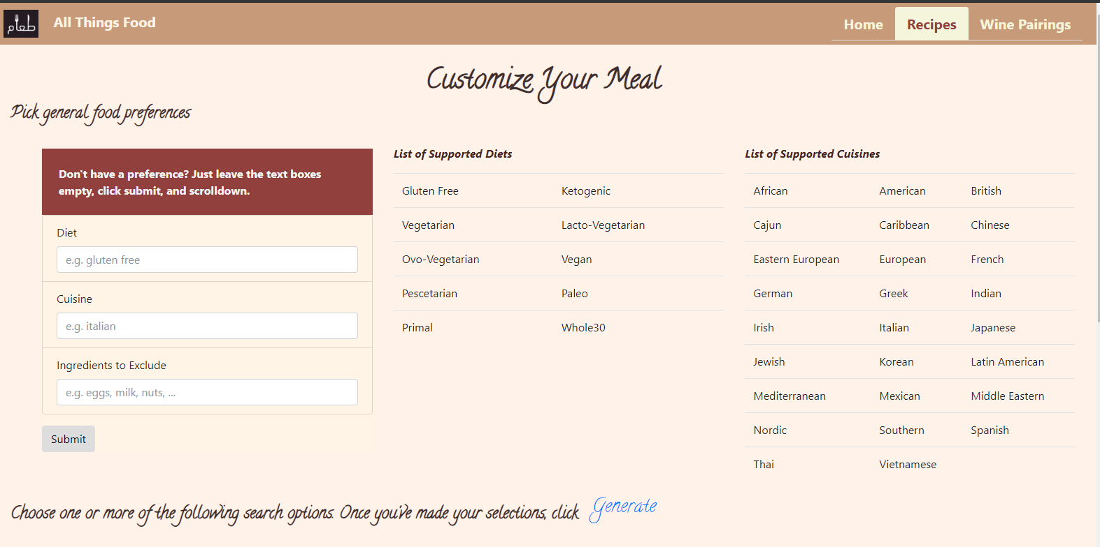
The webpage
outline

Slide 5
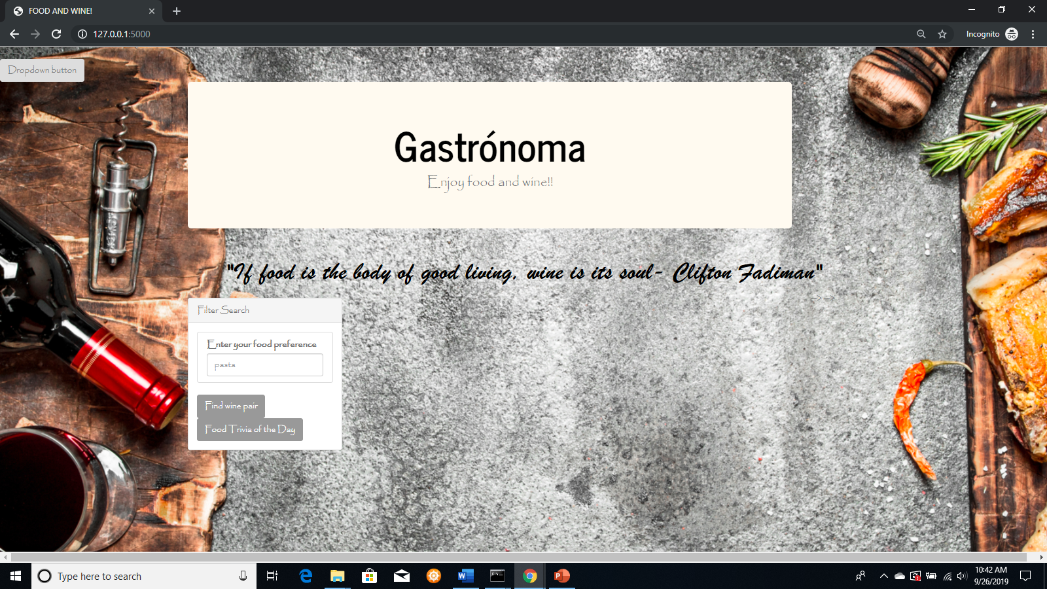
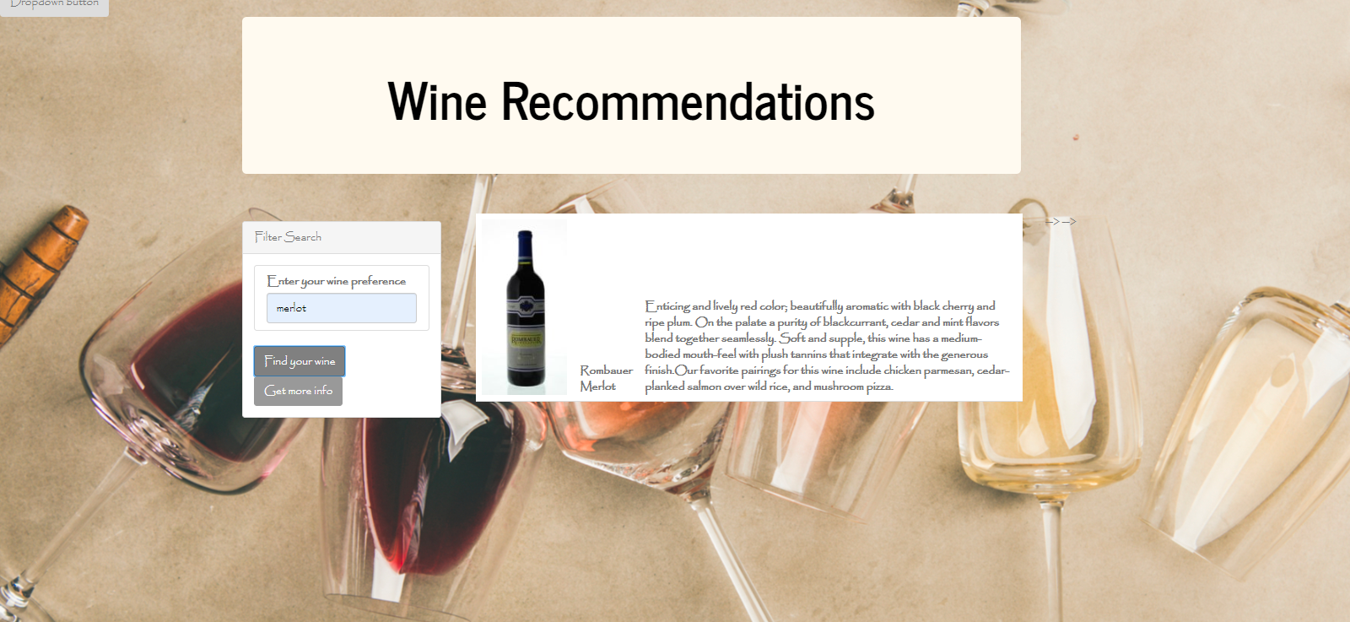
Subpages

Slide 6
Demonstration
The experience

Slide 7
Technical Challenges
Clearing out HTML tables
API Calls and cost
Relying on viable inputs
Integration of Pages
Handling multiple form inputs
Passing variables from Flask to D3

Slide 8
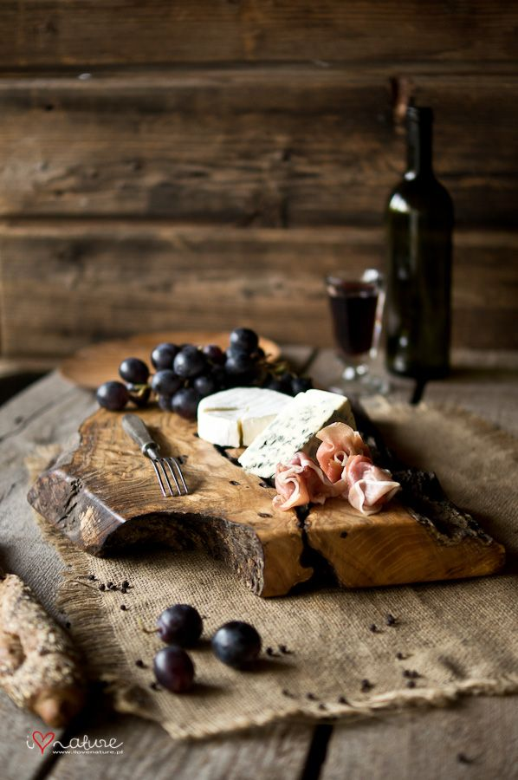
The importance of this App
Cut down on time for end-user
Customize unique meal plans with nutrition info
Get the end-user to explore wine and food combo

Slide 9
Conclusion
D3 and force functions
Troubleshooting connection to HTML from app routes
The complexity of integrating all applications
Quicker retrieval of recipes
Allowing user profiles

